Slide 1
21. DFS implementation;
Directed Graphs
ECE 309
Dr. James Tuck

Slide 2
Objectives
Implement the recursive version of Depth-First Search.
Define directed graph and give an example.
Explain how to represent a directed graph in code.
Describe weighted graphs, and give examples of what the weight might mean.

Slide 3
C++ recursive function implementation
void DepthFirstSearch(SparseGraph &g, IntegerSet &visitedSet, int node){ if ( !visitedSet.search(node) ) {
visit(node); // take action upon visit to node visitedSet.insert(node); for (SparseGraph::adjacency_iterator it=g.getAdjacencyList(node);
!it.end();
it.increment()) DepthFirstSearch(g,visitedSet,it.getItem());
} // end if
} // end function

Slide 4
C++ DFS class using inheritance
class DepthFirstSearch {
protected:
SparseGraph &g; IntegerSetHT visitedSet;
void dfs_helper(int node); //modified code from prior slide
public:
DepthFirstSearch(SparseGraph &ag):g(ag),visitedSet(1000){};
void run(int start) { dfs_helper(start); }
virtual void visit(int node){}// extend this class to customize visit
};
class PrintDFSOrder : public DepthFirstSearch {
public:
PrintDFSOrder(SparseGraph &g):DepthFirstSearch(g){}
void visit(int node) override { printf(“%d “,node); };
};

Slide 5
C++ DFS class using a functor object
template <class F>
class DFS {
protected:
SparseGraph &g;
IntegerSetHT visitedSet;
F visit; // functor object
void dfs_helper(int node); //modified code from prior slide
public:
DFS(SparseGraph &ag):g(ag),visitedSet(1000){};
void run(int start) { dfs_helper(start); }
};
class F { public: void operator() (int node) { printf(“%d”,node); } };

Slide 6
Directed Graphs
A directed graph, or digraph, consists of vertices connected by directed edges.
A directed edge is a connection between a starting vertex and a terminating vertex.
The start vertex is sometimes called the source.
The terminating vertex is sometimes called the destination.
Usually drawn as an arrow, pointing from source to destination.

Slide 7
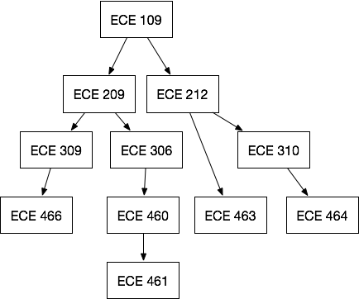
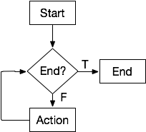
Examples of directed graphs

Slide 8
Adjacency in a directed graph
Node Y is adjacent to node X if there is an edge from X to Y.
209 is adjacent to 109.
463 is adjacent to 212.
464 is adjacent to 310.
109 is not adjacent to 209.
463 is not adjacent to 464.

Slide 9
Representation of directed graphs
Adjacency lists and matrices are still effective representations
Y adjacent-to X does not imply X adjacent-to Y.
We only connect an edge in one direction.
Note: pointers are also a good way to represent an edge, since they are inherently directional.

Slide 10
Paths and cycles in directed graphs
A path is a sequence of directed edges leading from a source (starting) vertex to a destination (ending) vertex.
A cycle is a path that starts and ends at the same vertex.

Slide 11
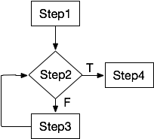
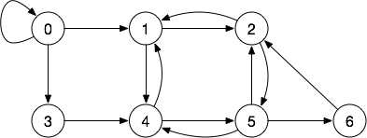
Examples of cycles
Cycles:
2,6,5
1,2,5,4
1,4,5,2
0,0
Cycle: Step2,Step3,Step2

Slide 12
Two kinds of directed graphs
Cyclic: At least one cycle is present in the graph.
Flowcharts are cyclic directed graphs (e.g. they have loops)
Acyclic: No cycles are present in the graph
Often abbreviated DAG: directed acyclic graph
Important class of graphs that show up everywhere!
Useful in scheduling problems, partial orderings

Slide 13
Weighted Graphs
A weighted graph associates a weight with each edge.
An edge's weight, or cost, represents some numerical value between vertices:
Flight cost between airports
connection speed between computers
travel time between cities.
A weighted graph may be directed or undirected.

Slide 14
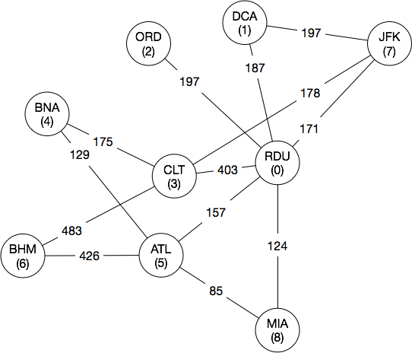
Example (1) of weighted graphs
Each node is an airport.
An edge represents a direct flight.
The weight is the cheapest cost of a non-stop flight as reported by Google.

Slide 15
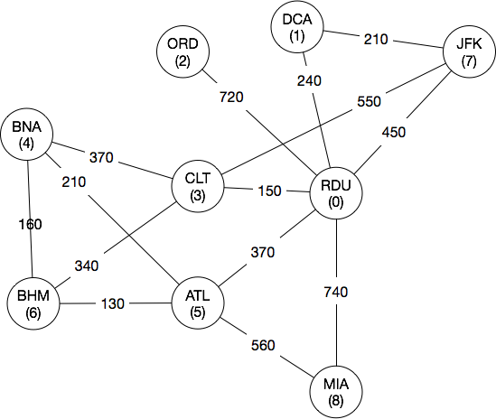
Example (2) of weighted graphs
Each node is a city.
An edge represents highways between two cities.
The weight is the time to drive the fastest path between them as reported by Google Maps.

Slide 16
Representation of weighted graphs
Two general strategies (variations possible):
Adjacency lists with extra information stored in each list-node.
Adjacency matrix with a corresponding weight matrix.

Slide 17
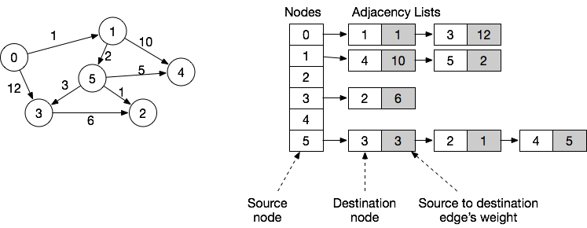
Adjacency list with weight information
For each entry in the adjacency list, an object holds the adjacent node’s number and the weight on the edge to get there.

Slide 18
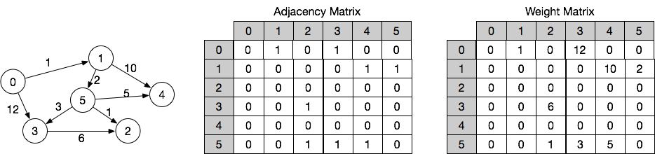
Adjacency matrix with weight information
For each edge in the adjacency matrix, the weight matrix holds its weight.
Alternative design: make each entry in the matrix a class with two fields: a boolean to indicate if the edge exists, and an integer to hold the weight.

Slide 19
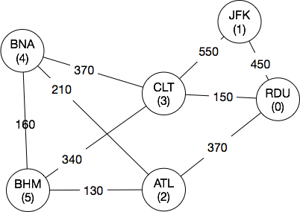
Example
Represent the weighted graph shown below in code.

Slide 20
Example
Represent the weighted graph shown below in code.
What’s the shortest route from X to Y?

Slide 21
Summary
Directed graphs have edges with a source and destination; adjacency is limited to the direction of the arrow.
Directed graphs come in two forms: those with cycles (e.g. flowcharts, and those without cycles (called directed acyclic graphs, DAGs).
Weighted graphs make it possible to add extra information, like cost, time, or distance onto a graph.

Slide 22
References
1. ZyBook on Data Structures, chapters 19.5 to 19.8

